Slide 1
SEMINAR
Sandra Anna Joshy
S2MSc computer science

Slide 2
WELCOME

Slide 3
Tuple Relation Calculus and Domain Relation Calculus
Contents
Introduction
Tuple relation calculus
formal definition
safety of expression
example queries
Domain relation calculus
formal definition
safety expression
example queries

Slide 4
RELATIONAL CALCULUS
Relational calculus is a non-procedural query language,that tells what to do but never explains how to do.
Relational calculus is of two types:
1.Tuple relational calculus
2.Domain relational calculus

Slide 5
1.TUPLE RELATION CALCULUS

Slide 6
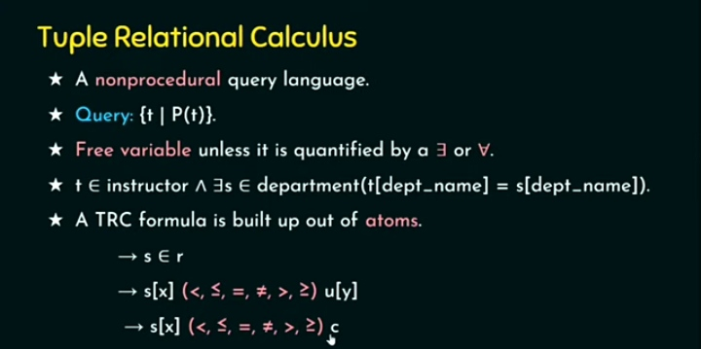

Slide 7
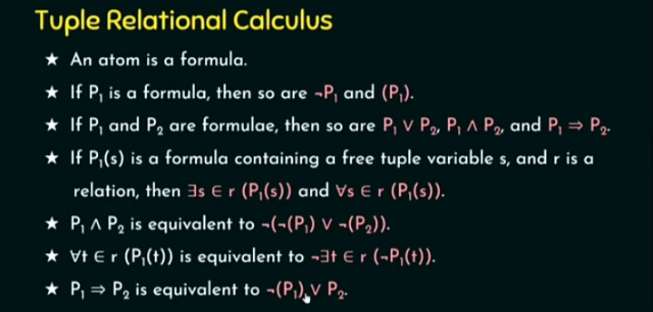

Slide 8
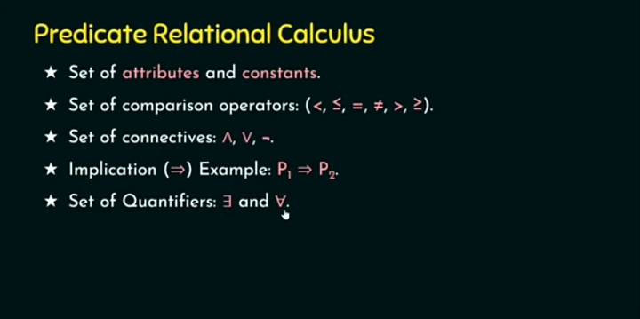

Slide 9
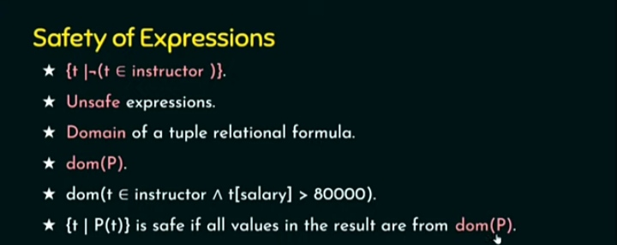

Slide 10
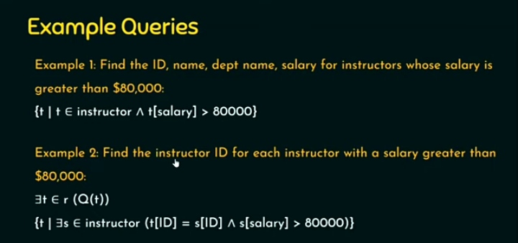

Slide 11
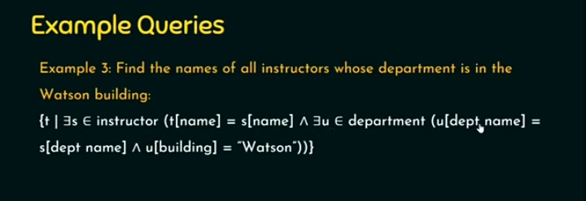

Slide 12
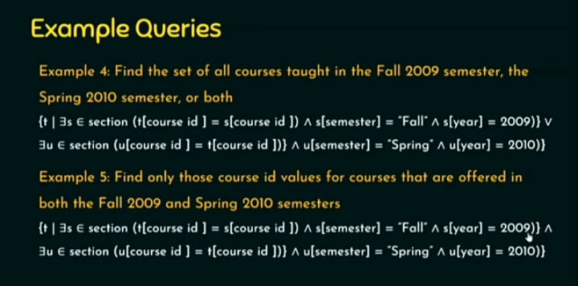

Slide 13
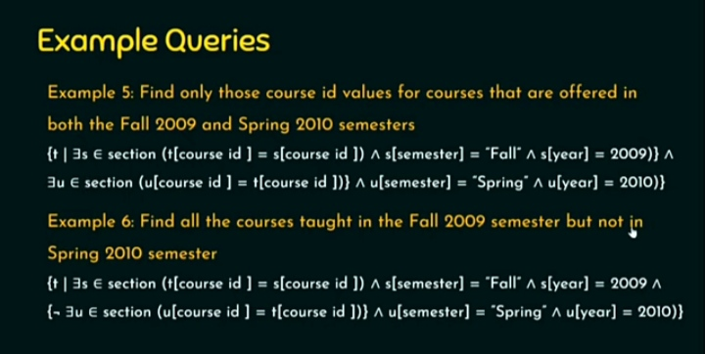

Slide 14
2.DOMAIN RELATION CALCULUS

Slide 15
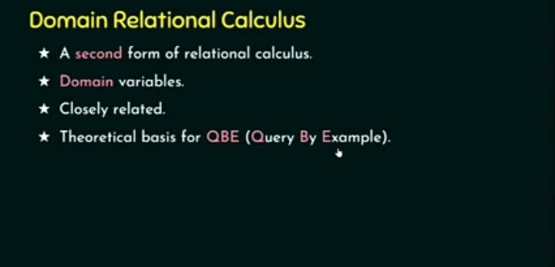

Slide 16
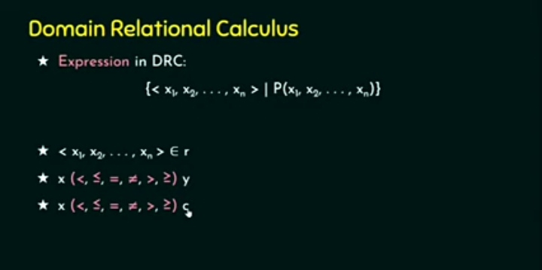

Slide 17
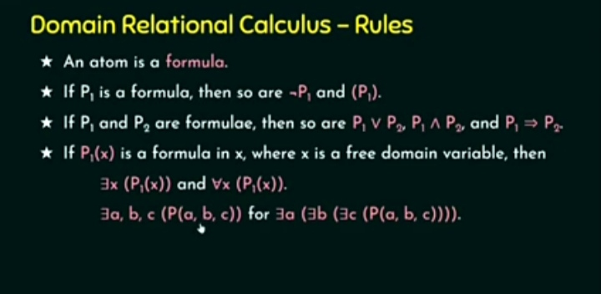

Slide 18
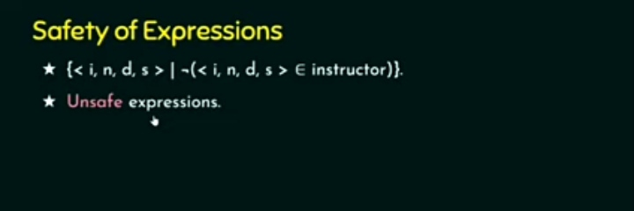

Slide 19
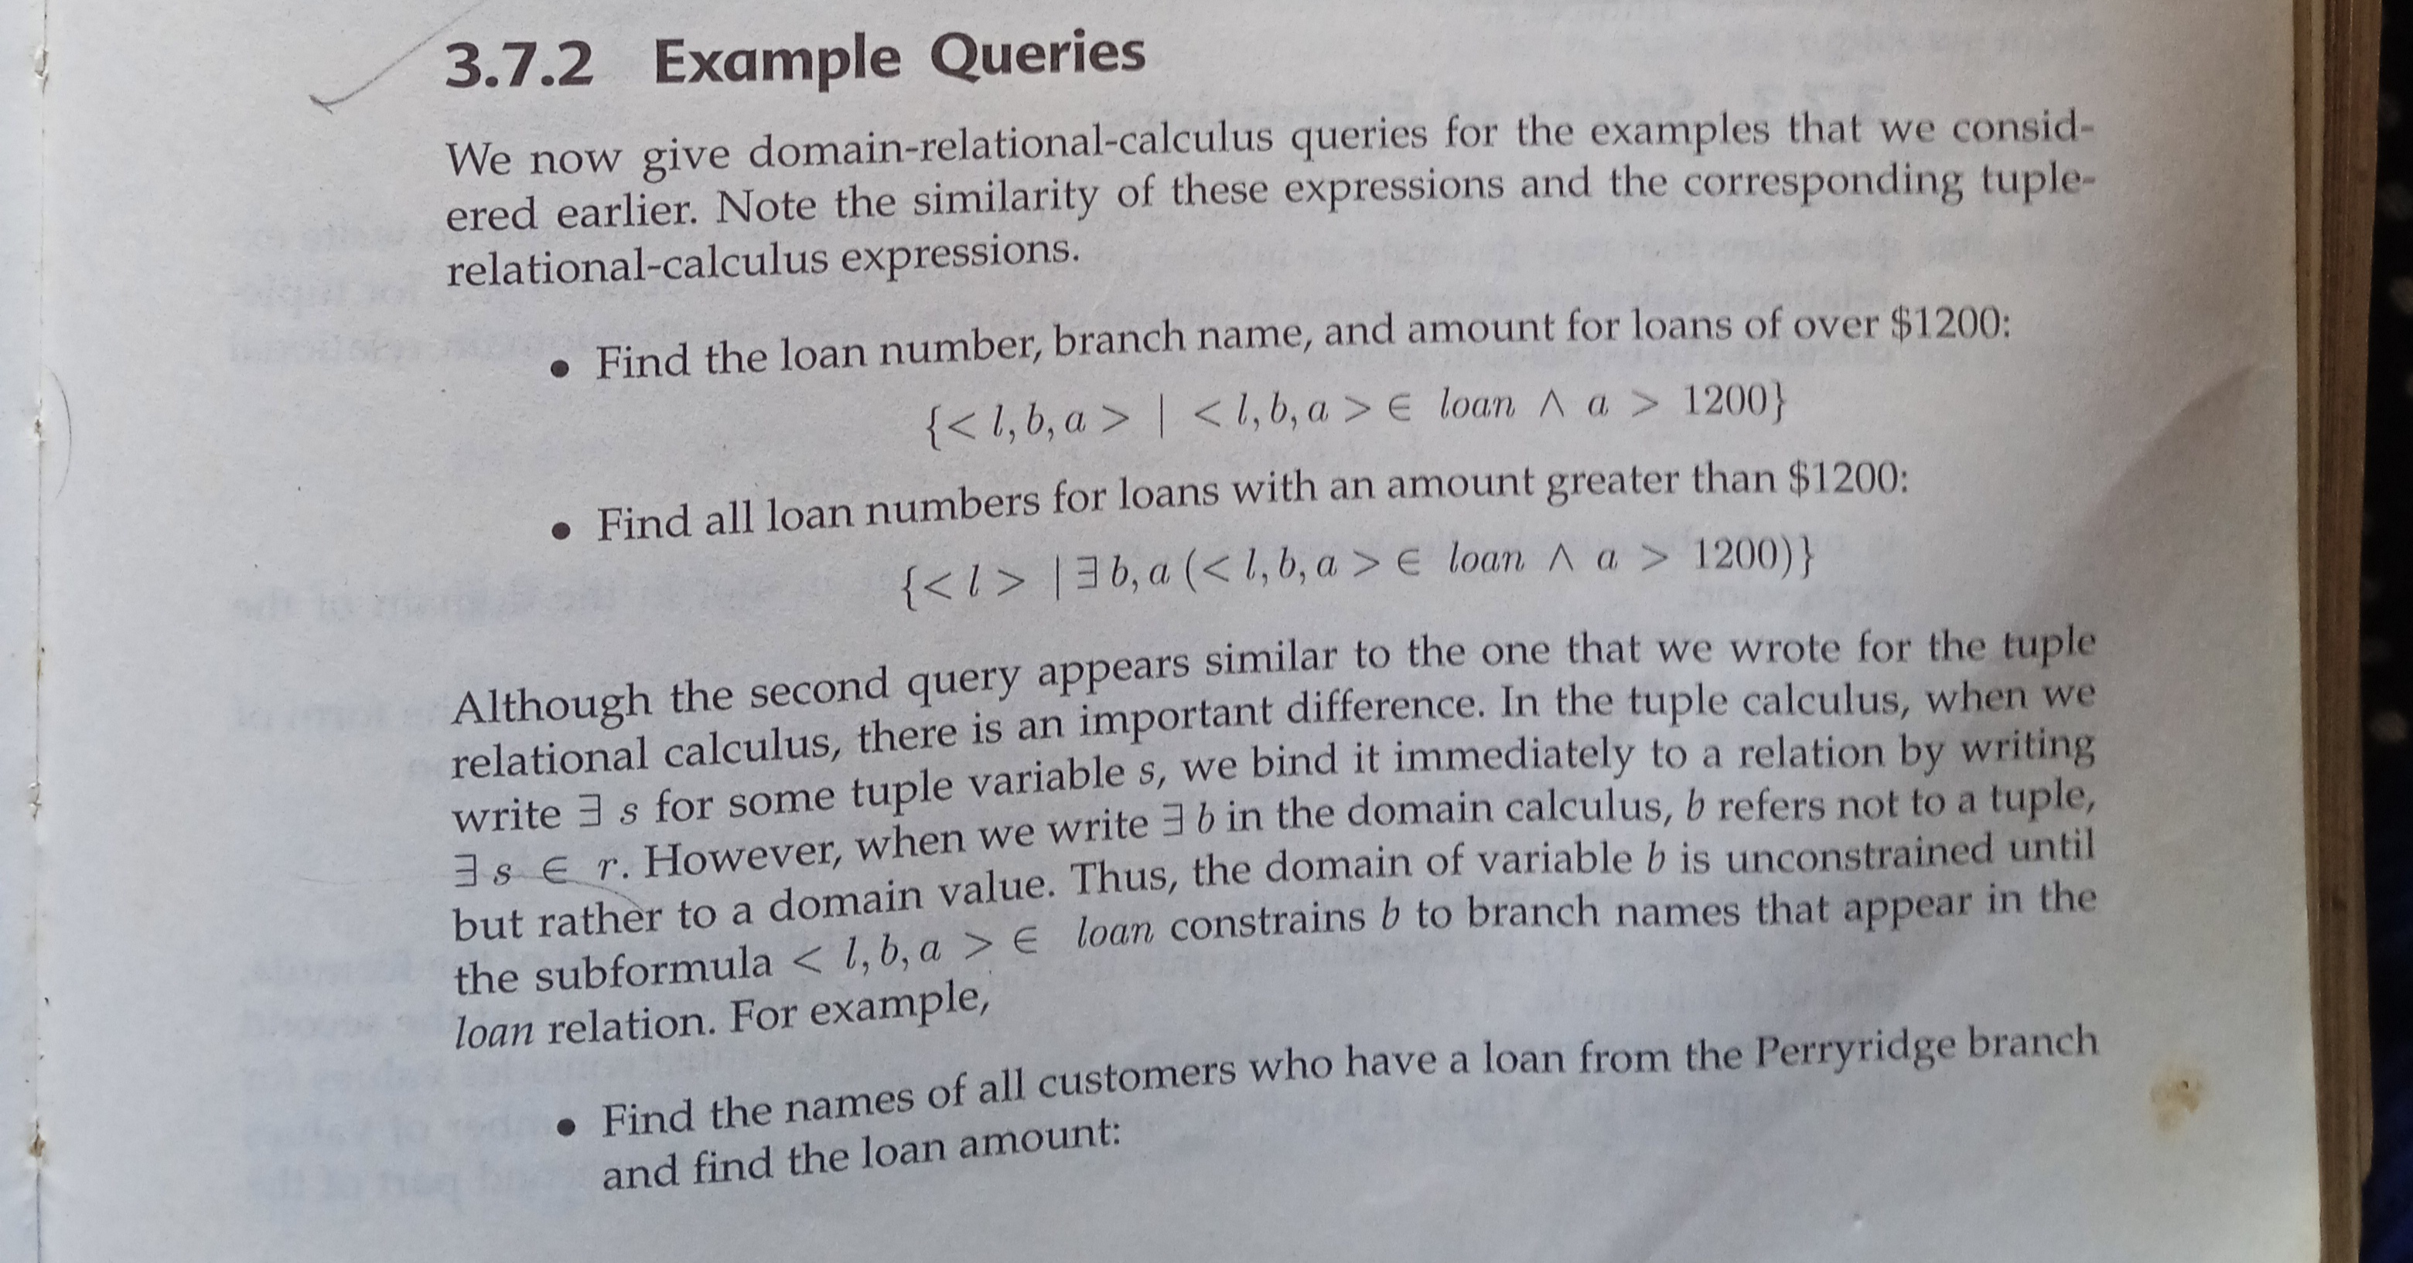

Slide 20
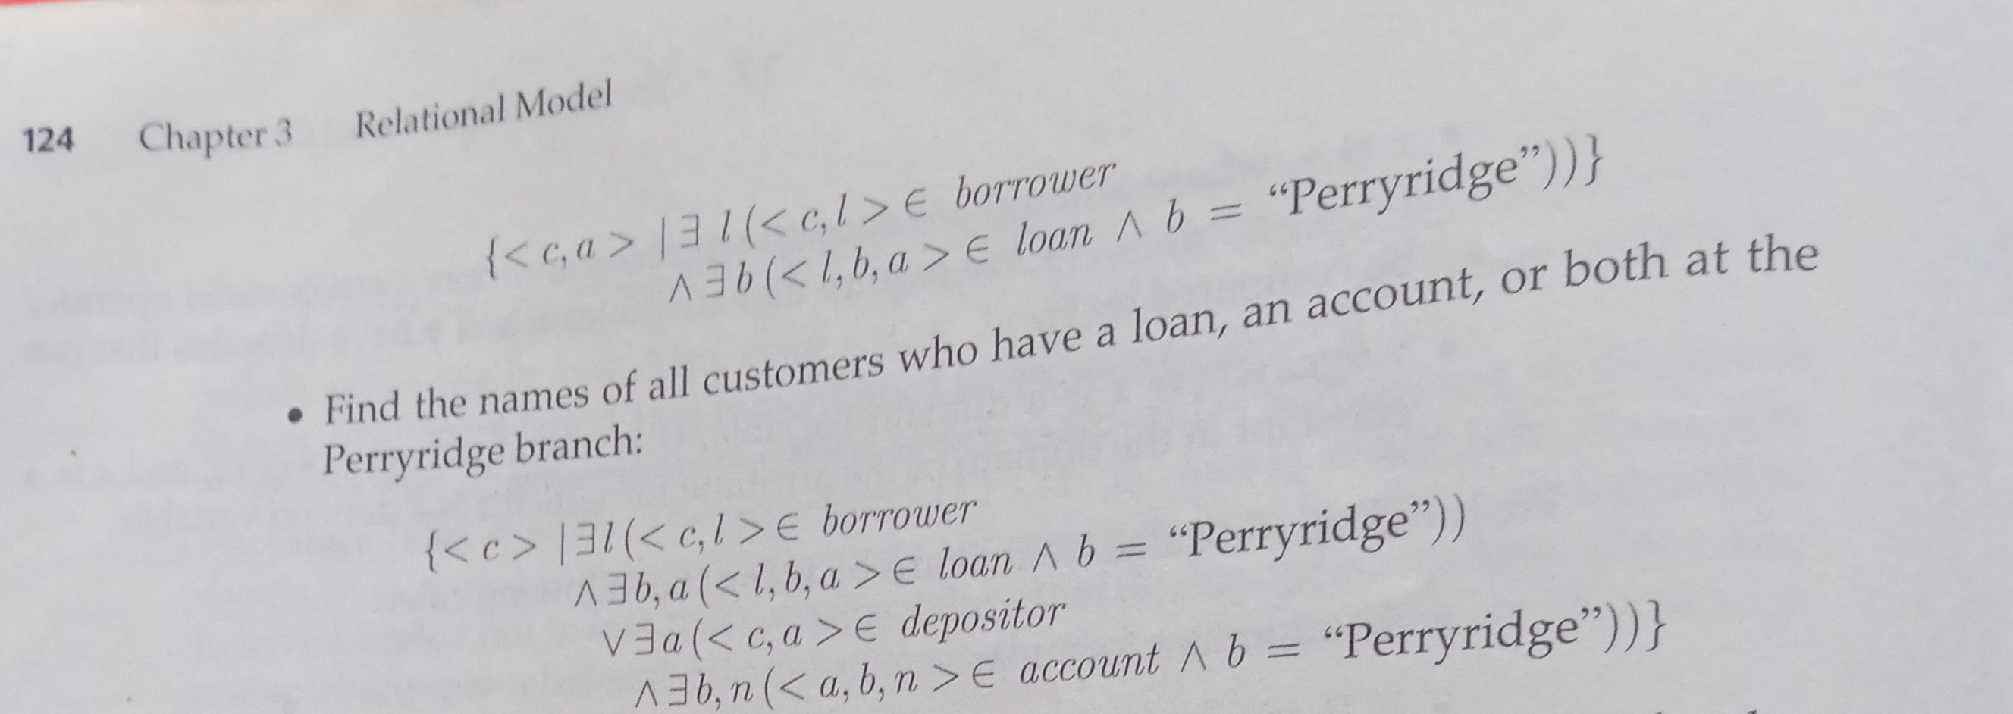

Slide 21
THANK YOU

